Slide 1
Transitioning to Adulthood
Developing an Individual Day Program
“Perfect Day”

Slide 2
Background
Slide content based on educational sessions developed for Parents/Caregivers of adults with IDD in Iredell County, NC to help parents plan for transition to adulthood:
Pre-Transition
Transition
Adult Services
Special Services
Health & Wellness
Sports & Recreation
Parent/Caregiver Retirement
Preparing for Client Death
Parent/Caregiver Deceased
Note: Resources based on North Carolina and neighboring states
CLS Talks

Slide 3
Transition Options
Higher Functioning
Wingate University
Julia’s Community
Appalachian State University
Scholars with Diverse Abilities Program
Autism Speaks Chapter
Western Carolina University
University Participant (UP) Program
Other College Programs for Disabilities
Marshall University - WV Autism Training Center
Beacon College - Leesburg, FL
Industry
The Precisionists
Mid-Level Functioning
Supported Employment
PACE Enterprises
Bitty & Beau’s
Cakeables
McDonald’s
Higher Level of Independence
Note: Resources based on North Carolina and neighboring states
CLS Talks

Slide 4
Transition Options
Lower Functioning
Select an Agency Provider
One-on-One Support (RAP or Caregiver)
Create Daily Schedule
Faith-based
Supported Employment
Educational/Skill Building
Recreational
Professional Services
Community Living and Support (CLS) = 28* hrs
Supported Employment = 12* hrs
What Would You Like Your Son’s Day to Look Like?
Summit DD Akron OH
* Dependent on Home & Community Based Services (HCBS) Waiver program
CLS Talks

Slide 5
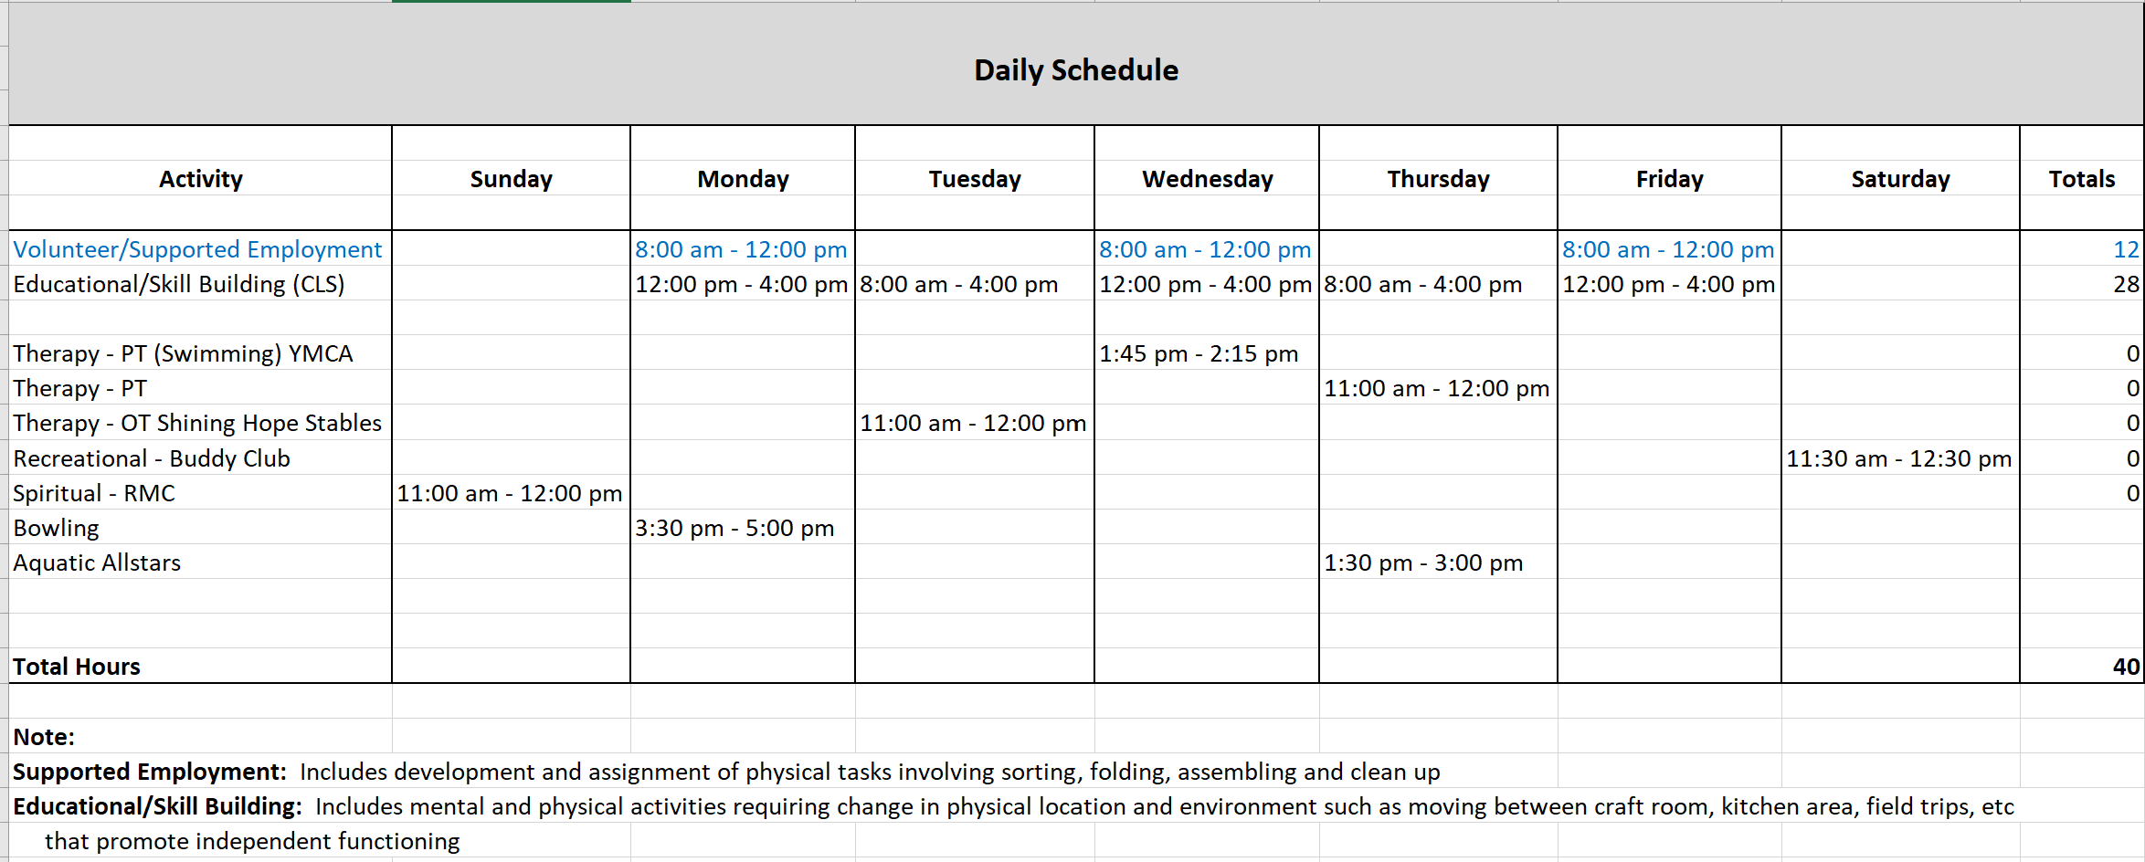
Schedule Template
CLS Talks

