Slide 1
The CoRDS Registry at Sanford

Slide 2
SANFORD HEALTH FOOTPRINT

Slide 3
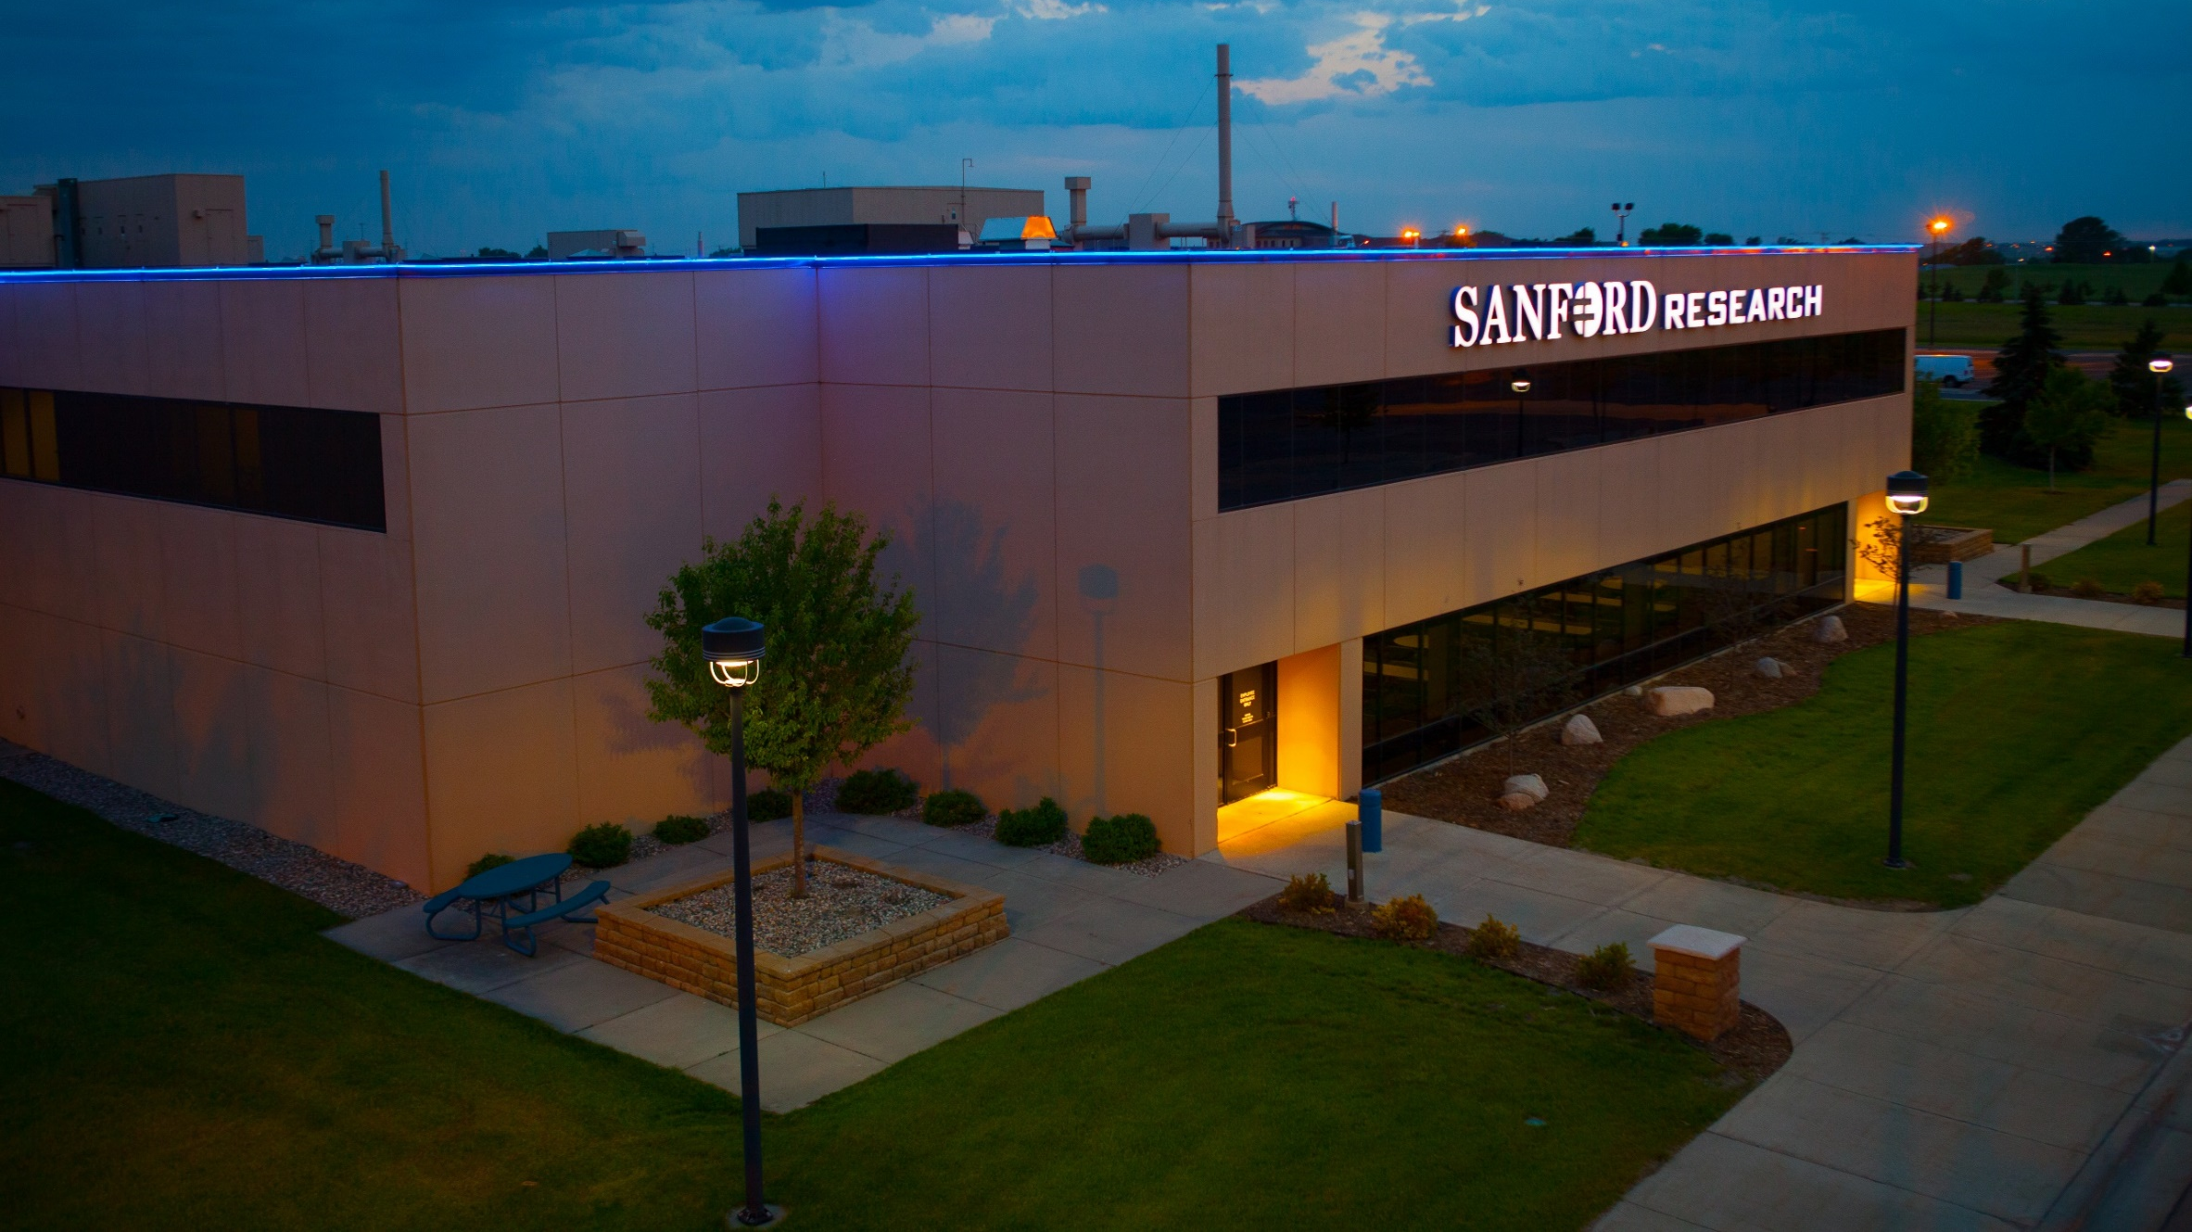
Fields of Research
Our researchers are building the foundation for future treatments and driving evidence-based care
Batten Disease
Behavioral Science
Pediatrics and Rare Diseases
Alagille Syndrome
Cancer and Immunotherapies
Genetics & Genomics
Cellular Therapies
Diabetes

Slide 4
Patient Centered Approach
We understand that in rare disease, many times the patients and their family members are the experts
In order to properly investigate a disease, researchers must have a full understanding of the disease’s natural history.
Out of these two ideas, Sanford Health has sponsored the development of the CoRDS Registry.
YOU are the expert

Slide 5
CoRDS Mission & Vision
Bringing together patients and researchers to accelerate rare disease treatments.
As a hospital system and research organization, Sanford Health sponsors our efforts to build the most robust, cost free, rare disease registry in the world. With our innovative online platform, we will tie together researchers, patients, advocacy groups, and industry partners to catalyze the discovery of novel therapeutics for rare diseases.

Slide 6
So… what is a registry?
A patient registry is a collection of data captured regarding a group of patients.
This can include:
Contact information
Demographic information
Health information
Quality of Life information
This can be patient or clinician entered
A registry can serve as a way to contact members of a group later on, or it can serve to build up a story of the progression of a disease, called it’s “Natural History”

Slide 7
What is CORDS?
CoRDS is a patient registry for all rare diseases/conditions, carriers & the undiagnosed - it ties together patients, advocacy groups, and researchers.
CoRDS is made available at no cost to patients, advocacy groups, or researchers. It is free and it always will be.

Slide 8
How does CoRDS work?
Patients and their families can complete a questionnaire.
Advocates can compose a disease-specific questionnaire.
Participants enroll in CoRDS by completing the questionnaire(s) and keeping their record updated.
Researchers and clinicians can apply for access to the data in CoRDS
CoRDS

Slide 9
How can cords help?
CoRDS Connects patients’ natural history data with researchers and clinicians
Majority of rare diseases do not have a registry
Many rare disease cohorts have not yet found their community

Slide 10
Matchmaker

Slide 11
Who owns the data in cords?
Participants are the primary owners of the data because they control how the data is ultimately used.
CoRDS stores and manages the information as required by the Sanford Research Institutional Review Board (IRB).

Slide 12
Information security
CoRDS never sells, rents, or leases personal information.
Information in CoRDS remains there unless consent to share is provided by the participant or the participant withdrawals from the registry.
Patient Information

Slide 13
How is cords data used?
Researchers
Researchers will fill out the research access form to access the CoRDS data
Patient Advocacy Group
Can use data for non-research purposes (education, grant applications, etc.)
Only after participant has given consent to share
Pharma
Industry can notify CoRDS of disease specific clinical trials. CoRDS will then direct participants to the appropriate pharma contact if interested in learning more about a clinical study.
The requested data can be approved by Sanford’s Scientific Review Committee, to receive de-identified patient data

Slide 15
Enroll in cords today!
https://cords.sanfordresearch.org/activation-form

Slide 16
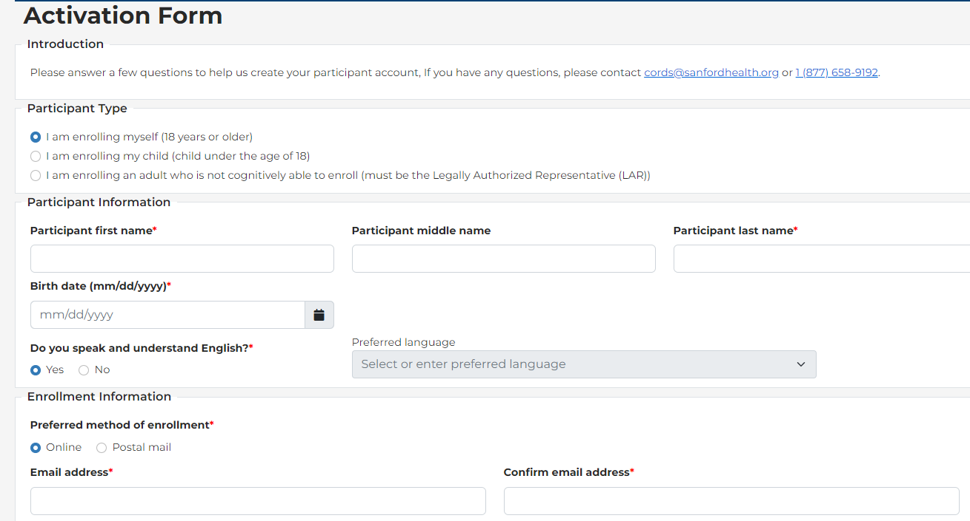

Slide 18
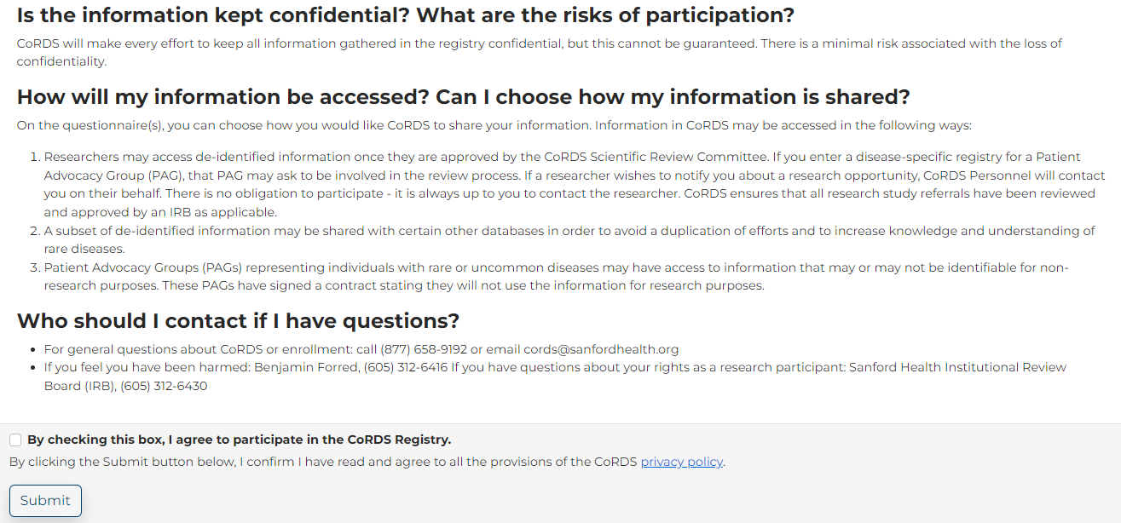

Slide 20
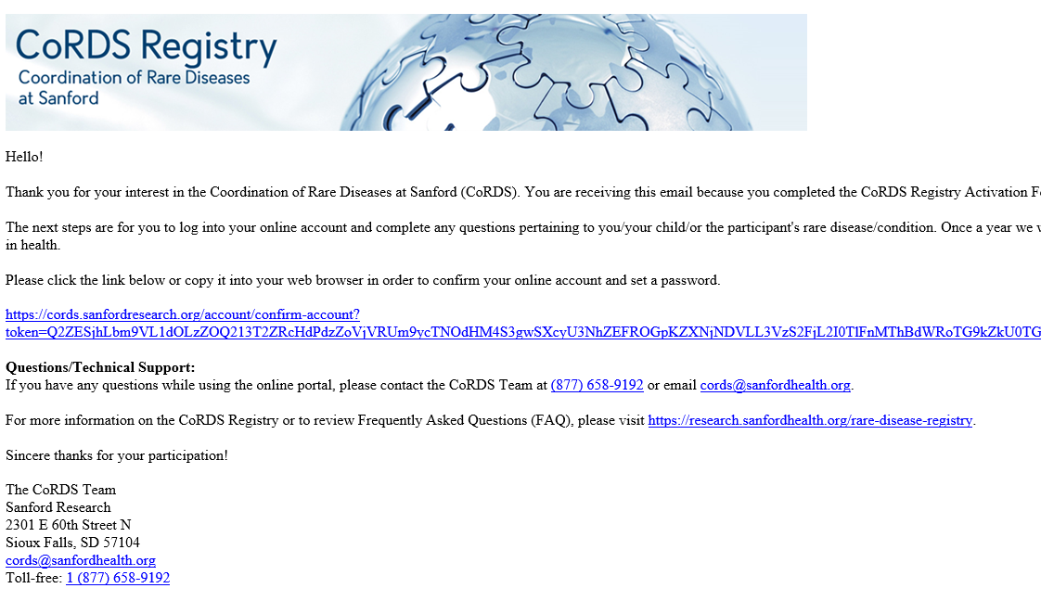

Slide 21
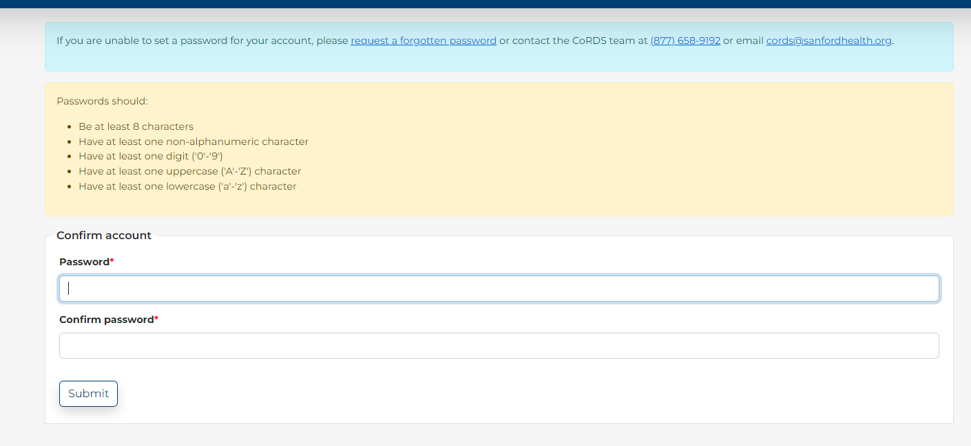

Slide 22
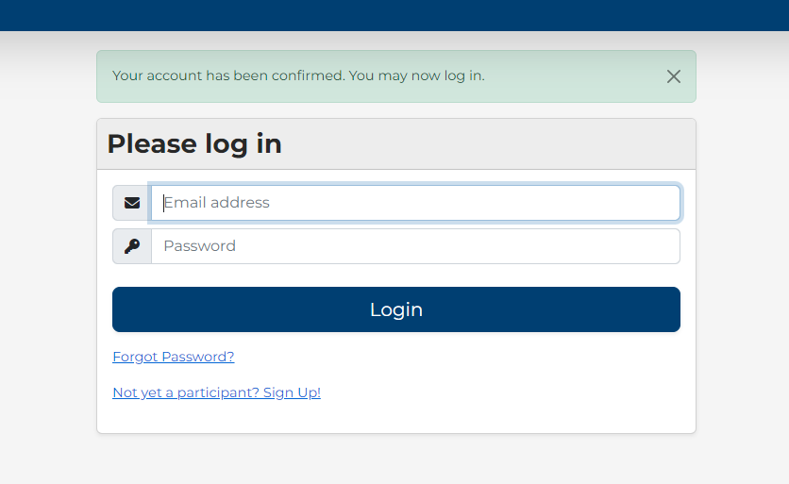

Slide 23
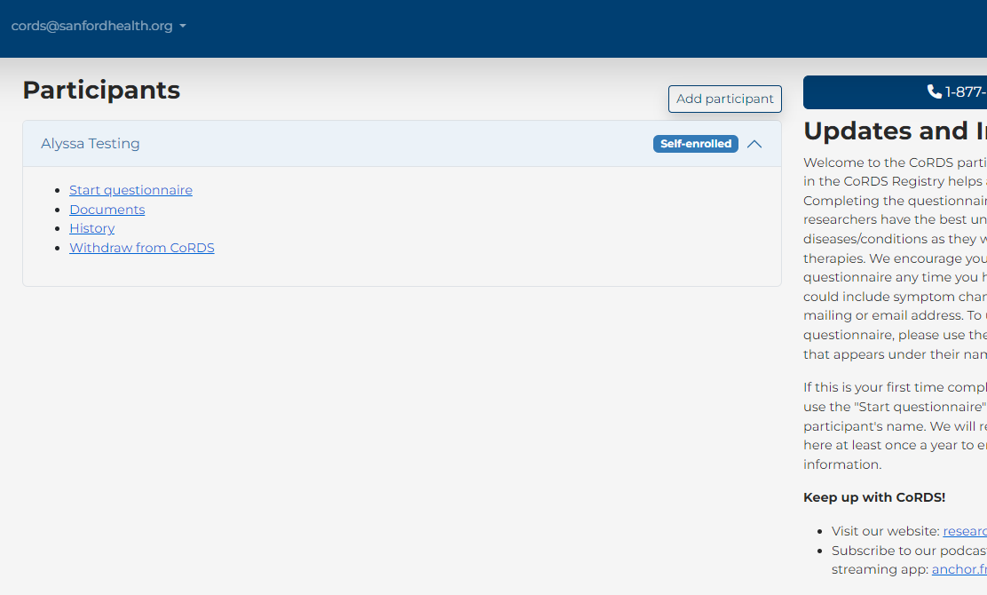

Slide 24
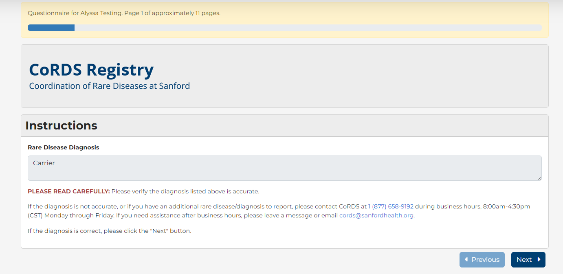

Slide 25
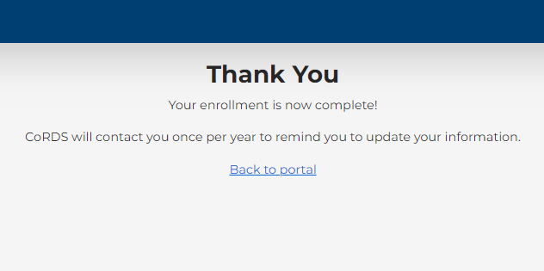

Slide 26
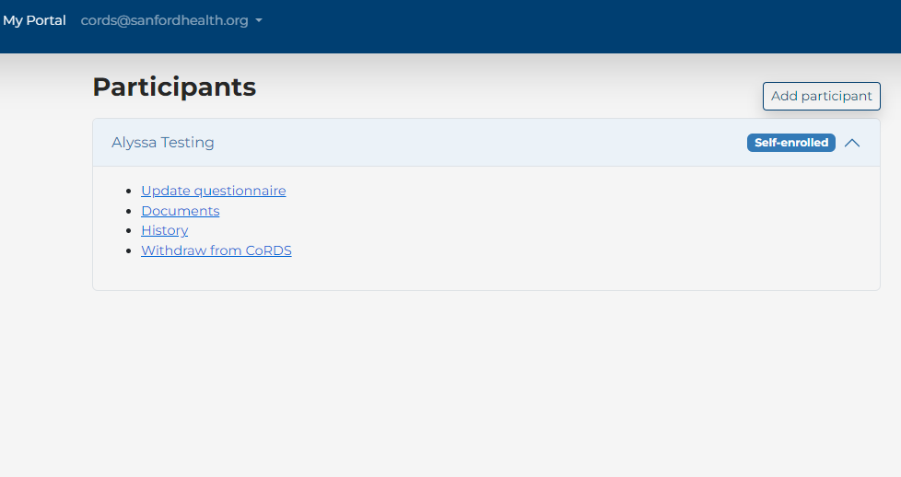

Slide 28
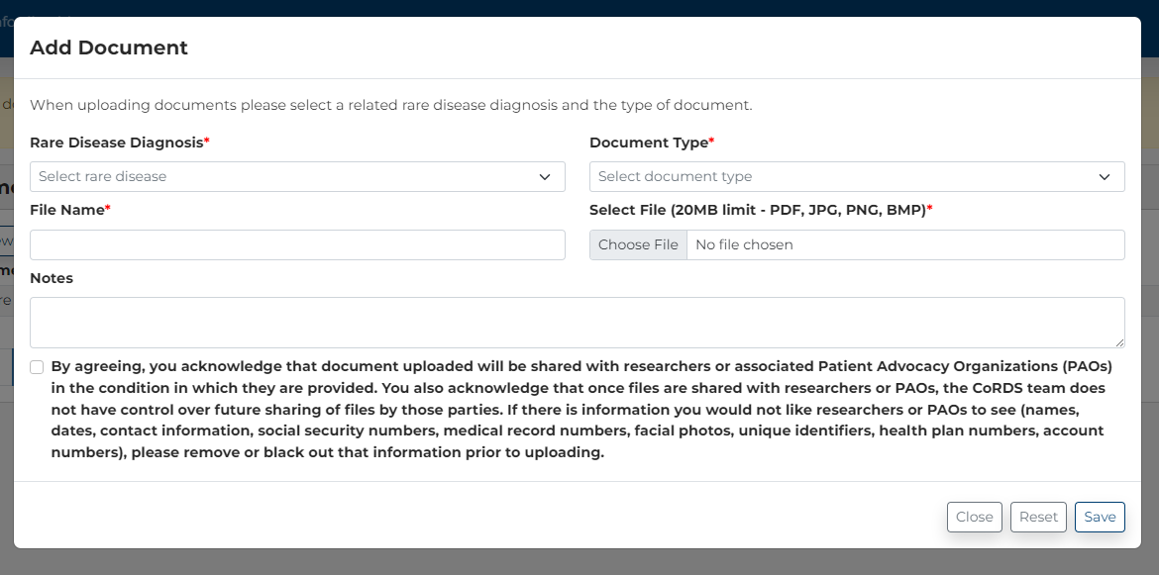

Slide 30
Over 150 researchers have accessed cords data or used cords to help with clinical trial/study recruitment
Acadia University ADVARRA Aceragen Adelphi Values Allegheny Health Network Ambit Inc Ambry Genetics AnnJi Pharmaceutical Co Atlas Primary, Inc. AVROBIO Baylor College of Medicine BCM Biohaven Boston Children's Hospital Bradley Hospital/ Brown California University CCHMC Centre for Molecular Medicine and Innovative Therapeutics, Murdoch University Cincinnati Children's Hospital Clinic for Special Children CNMC Columbia University Irving Medical Center CONCORDIA UNIVERSITY Cornell Cour Pharma Department of Neurology, Nagoya University Graduate Engage Health
Escola Paulista de Medicina - Universidade Federal de
São Paulo
Ferox Therapeutics
gMendel
Harmony Biosciences
Ionis Pharmaceuticals
John Carroll University Johns Hopkins School of Medicine
Kantar Health
Khure Health
Kynapse Leiden Analytics
Linköping University
Magnolia Innovation
Mahzi Therapeutics
Massachusetts General Hospital
Merck & Co., inc.
McGill University
MRC CBU University of Cambridge Murdoch University
National Marrow Donor Program/ Be The Match
Neuren Pharmaceuticals
NINDS, National Institutes of Health Northwestern University Feinberg School of
Medicine
Ocugen Inc Ohio State University
Optum
Pitie-Salpetriere Hospital, Paris, France
Precigen
PTC Therapeutics
Recordati
Regional Obstetrical Consultants
Sanford Research
Satellite Bio
SORA Chikatsuyu
Sumptuous Data Sciences
Teva
The Calliditas Therapeutics Group
Translational Genomics Research Institute
UC Irvine UCL Queen Square Institute of Neurology University of Boulder
University of California, Irvine
University of Central Florida
University of Colorado Boulder
University of Copenhagen
University of Delaware
University of Florida College of Medicine
University of Maryland Baltimore
University of Massachusetts
University of Miami University of Michigan
University of Minnesota
University of Pennsylvania
University of Rochester
University of Sussex
University of Virginia
University of Washington
University of Wisconsin–Madison
UTHealth
Weill Cornell Medicine, Dept of Genetic Medicine
Worldwide Clinical Trials
Wayne State University
WVU Medicine

Slide 31
Check out our podcast!!!

Slide 32
Thank you!
cords@sanfordhealth.org
www.sanfordresearch.org

Slide 33
Questions

